Slide 1
CE 3372 Water Systems Design
Lesson 20: design storms on small sub-catchments

Slide 2








Outline
Hydrology
Design Storms (Review)
Application to Tanglewilde Example

Slide 3
Design hyetographs
Also called design storms

Slide 4
Hyetographs
The IDF approach only estimates average rate (over an averaging time)
When time behavior of a storm is important then we have to generate hyetographs (time series of rainfall)
Design storms are statistical models of such temporal behavior and are used in hydrologic models when hydrographs need to be generated

Slide 5
Rainfall Distributions
Each “block” represents the amount of rainfall for the time interval
The diagram is called “incremental” rainfall
The running sum of the blocks is the cumulative distribution

Slide 6
Rainfall distributions
Distributions are created from historical storms and analyzed to generate statistical models of rainfall – these models are called design storms.
Design storm distributions are typically dimensionless hyetographs
NRCS Type Storms (24 hour, 6 hour)
Triangular Hyetograph Method
Empirical Texas Hyetographs (TxHYETO-2015)
Alternating Block Method
Instantaneous Intensity Method

Slide 7
SCS Rainfall Type Curves
SCS(1973) analyzed DDF curves to develop dimensionless rainfall temporal patterns called type curves for four different regions in the US.
SCS type curves are in the form of percentage mass (cumulative) curves based on 24-hr rainfall of the desired frequency.
Intended for use with the SCS Curve Number runoff generation model!

Slide 8
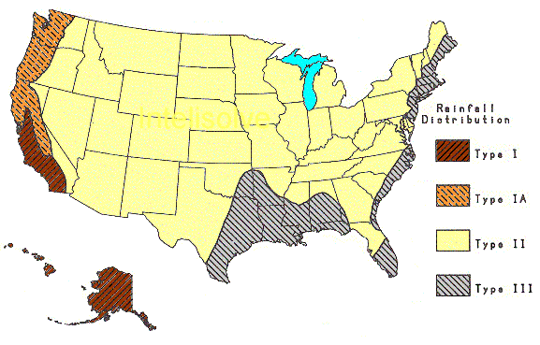
SCS Rainfall Type Curves
Location selects the Type Curve
Module 8

Slide 9
SCS Rainfall Type Curves
The 24-hour precipitation depth of desired frequency is specified (DDF Atlas), the SCS type curve is rescaled (multiplied by the known number) to get the time distribution.

Slide 10
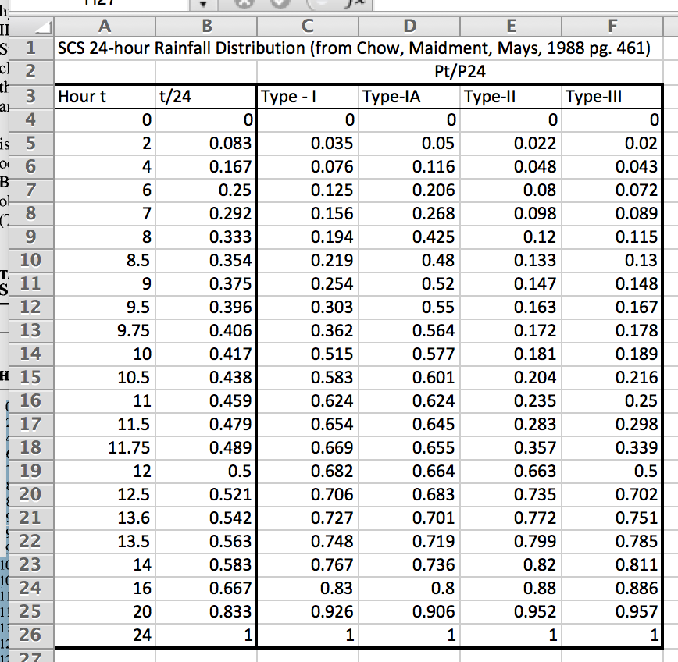
Rainfall distributions

Slide 11
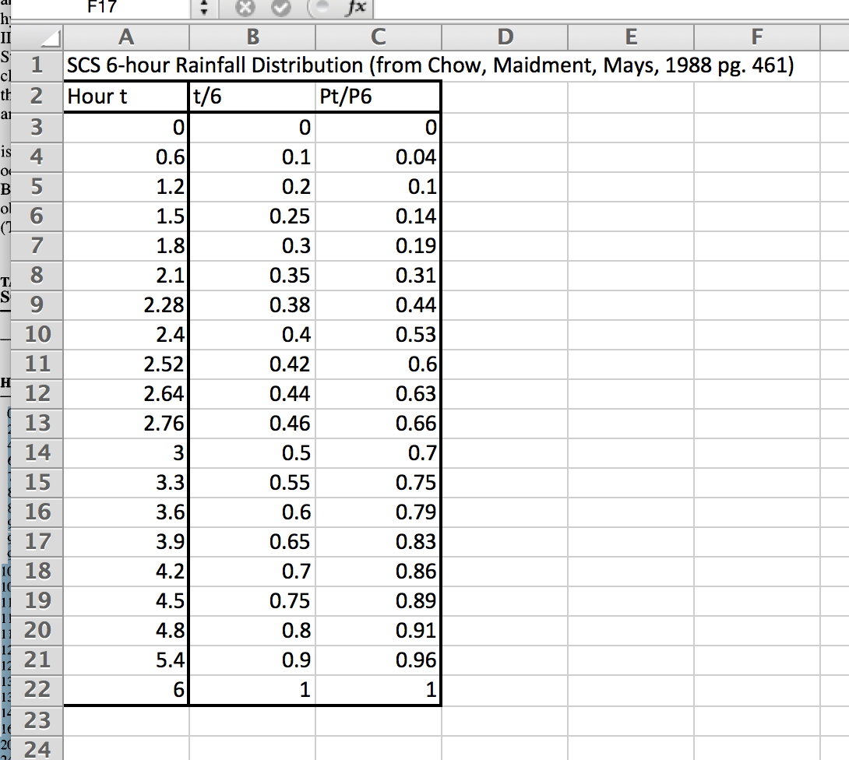
Rainfall distributions

Slide 12
SCS Rainfall Type Curves
Using the Type Curves
Use NOAA Atlas 14 DDF Atlas, TP-40, etc. to set total depth, P for the 24 hour storm (or 6 hour storm)
Pick appropriate SCS type curve (location).
Multiply (rescale) the type curve with P to get the design mass curve.
Get the incremental precipitation from the rescaled mass curve to develop the design hyetograph.

Slide 13
Example: SCS Design Storm
Generate a design hyetograph for a 25-year, 24-hour duration SCS Type-III storm in Harris County using a one-hour time increments
Look up 24-hour,25-year depth for Harris County in the NOAA Atlas 14, Vol. 11. DDF Atlas.
Cumulative fraction - interpolate SCS table
Cumulative rainfall = product of cumulative fraction * total 24-hour rainfall (10.01 in)
Incremental rainfall = difference between current and preceding cumulative rainfall
Plot results of incremental

Slide 14
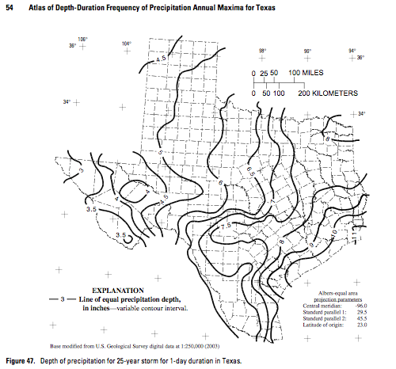
This slide is deprecated
Look up 24-hour,25-year depth for Harris County in the DDF Atlas.
P ~ 10 inches

Slide 15
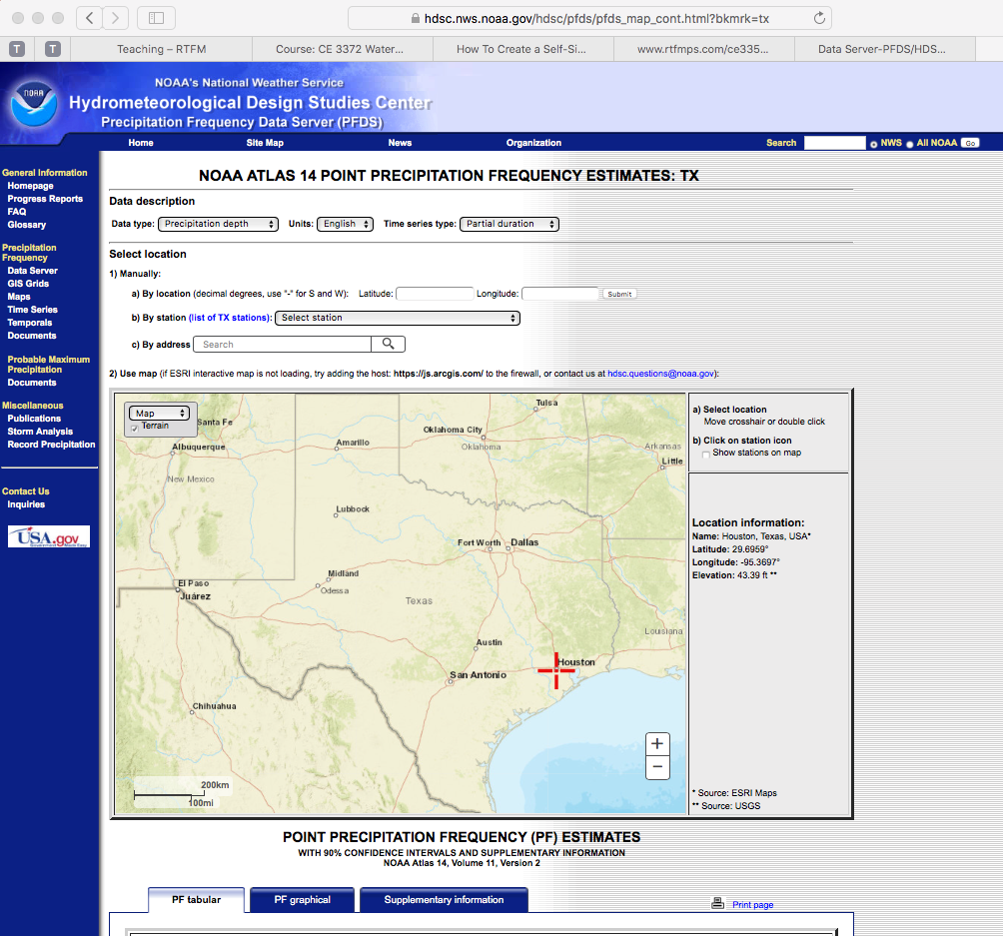
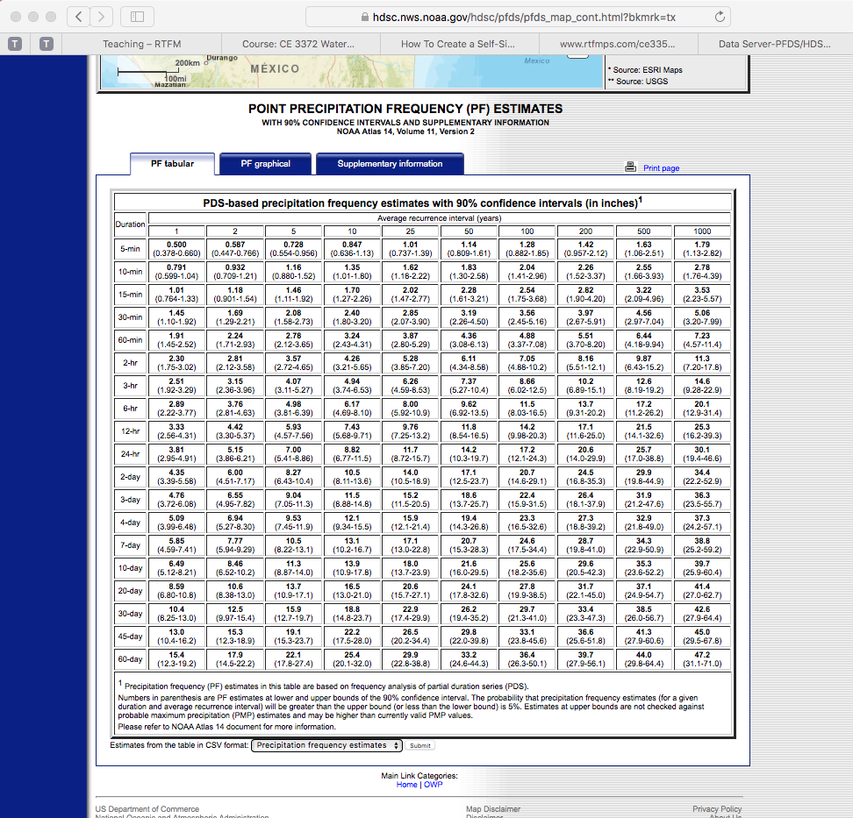
SCS DESIGN STORM
Look up 24-hour,25-year depth for Harris County in the DDF Atlas.
P ~ 11.7 inches

Slide 16
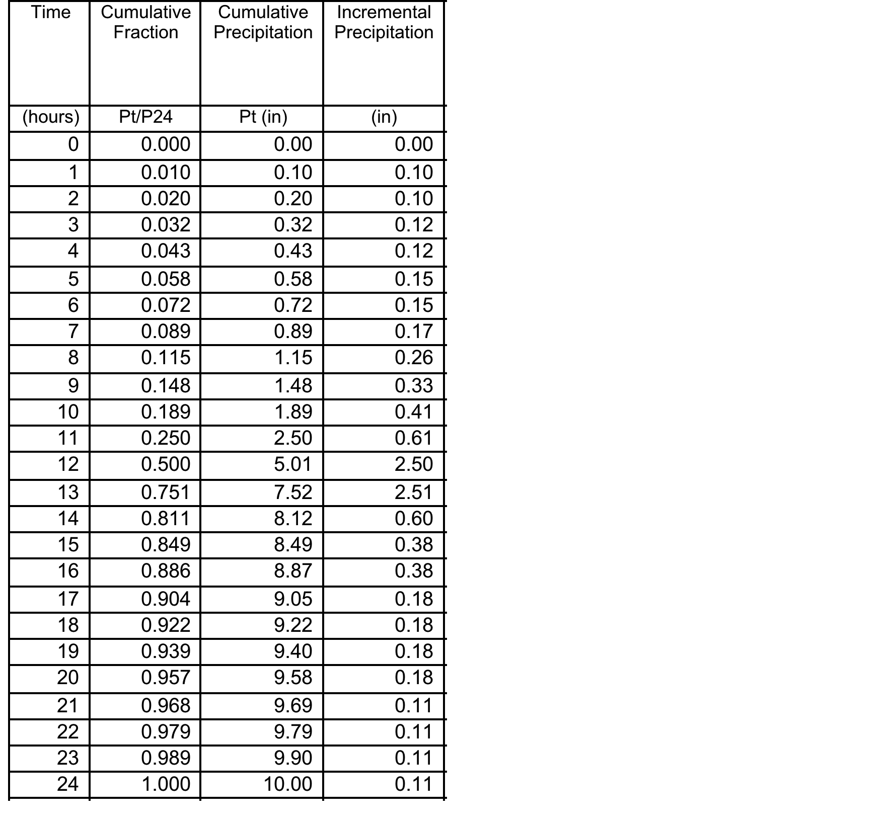
This slide is deprecated
SCS Tabulation
DDF Atlas
Module 8

Slide 17
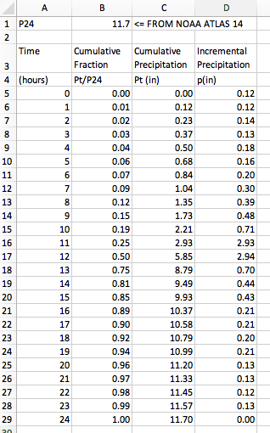
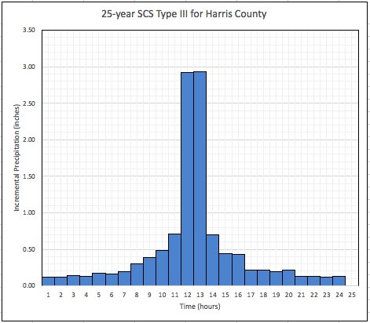
Example: SCS Design Storm
SCS Tabulation
NOAA Atlas 14, Vol. 11 DDF Atlas

Slide 18
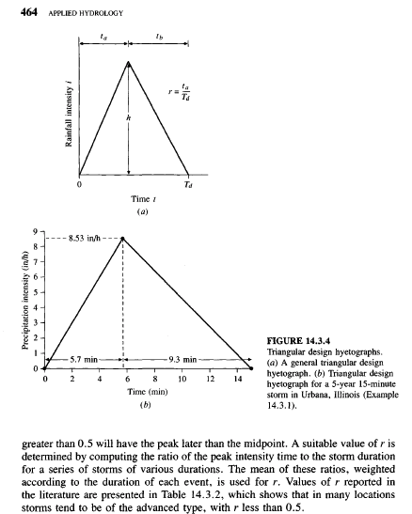
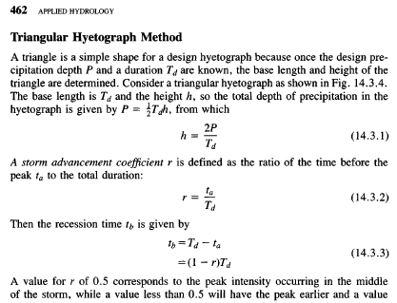
Triangular hyetograph method
Determine advancement coefficient
Time to peak
Total Time

Slide 19
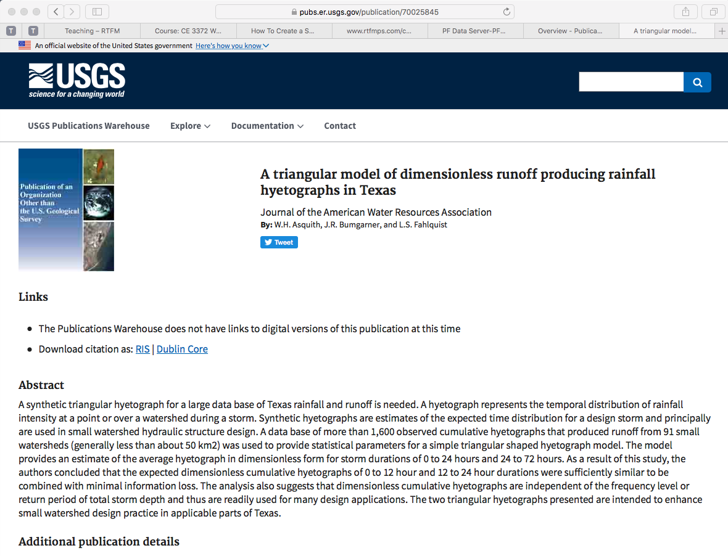
Triangular hyetograph method
Texas-specific

Slide 20

Texas Empirical Hyetographs
Alternative to SCS Type Curves is the Texas Empirical Hyetographs
Based on Texas data.
Reflects “front loading” observed in many real storms.
Rescales time and depth.

Slide 21
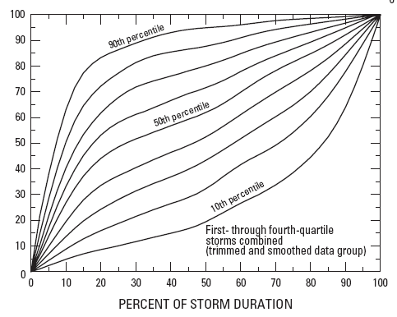
Texas Empirical Hyetographs
Rescale Depth
Average Intensity
Rescale Time

Slide 22
Texas Empirical Hyetographs
Use the 50th percentile curve (median storm).
Multiply the time axis by the storm duration.
Multiply the depth axis by the storm depth.
Result is a design storm for given duration and AEP.

Slide 23
Example: Texas Empirical Hyetographs
Construct a design storm for the 3-hour, 2-year rainfall in Harris County using the Texas Empirical Hyetograph
Obtain the depth from the DDF Atlas
Rescale the depth and time using the Texas Empirical Hyetograph
Module 8

Slide 24
Example: Texas Empirical Hyetographs
2.6 inches
1.3 inches
0 hours
1 hours
2 hours
3 hours

Slide 25
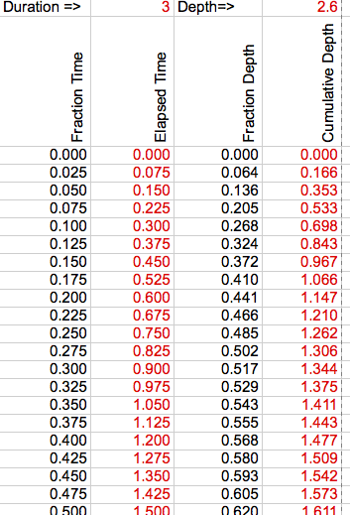
Example: Texas Empirical Hyetographs
Probably easier to use the tabulation
SIR-2004-5075

Slide 26
TxHYETO-2015
Texas Empirical Hyetograph tool that approximates the hyetographs using a function fit.
User supplies:
Depth
Duration
Desired Time Steps (increments)
Tool returns a time series of cumulative depth every increment (intended for copy-paste into HEC-HMS)

Slide 27
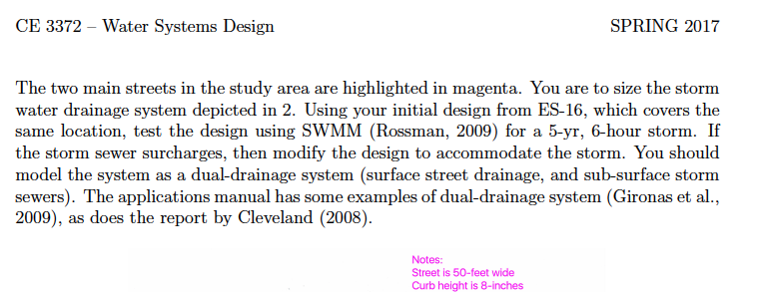
Application of design storm for tanglewilde
Using the Tanglewilde problem as an example

Slide 28
Application of design storm for tanglewilde
Using the Tanglewilde problem as an example
Does not specify storm type, so for completeness we will build using
SCS 6-hour
TXHYETO 6-hour

Slide 29
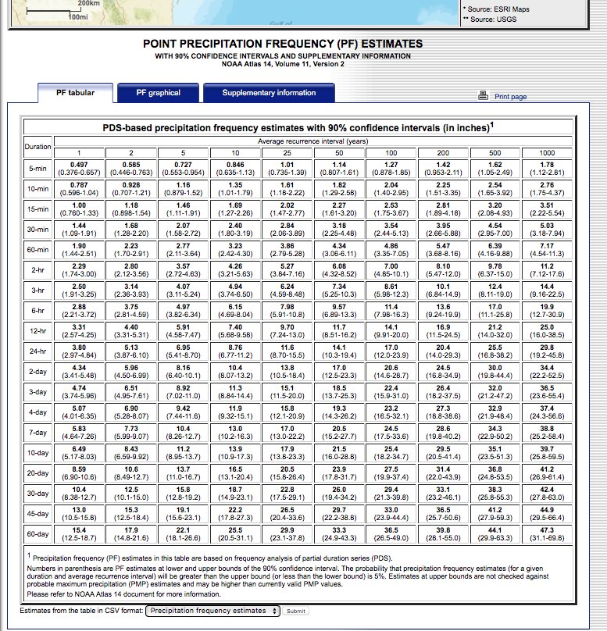
Application of design storm for tanglewilde
Using the Tanglewilde problem as an example
Does not specify storm type, so for completeness we will build using
SCS 6-hour
TXHYETO 6-hour
NOAA Atlas 14, Vol 11. 6-hour, 5-year depth is 4.97 inches

Slide 30
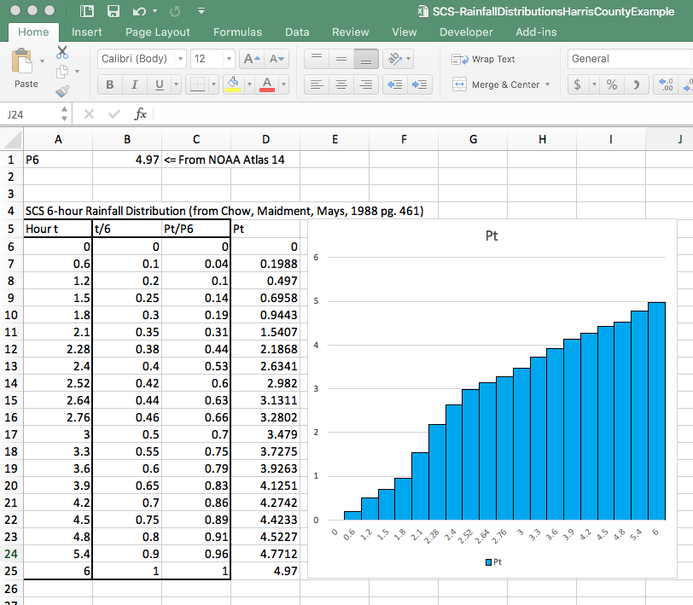
Application of design storm for tanglewilde
Using the Tanglewilde problem as an example
Does not specify storm type, so for completeness we will build using
SCS 6-hour
TXHYETO 6-hour
NOAA Atlas 14, Vol 11. 6-hour, 5-year depth is 4.97 inches
Use interpolation to get onto uniform time intervals

Slide 31
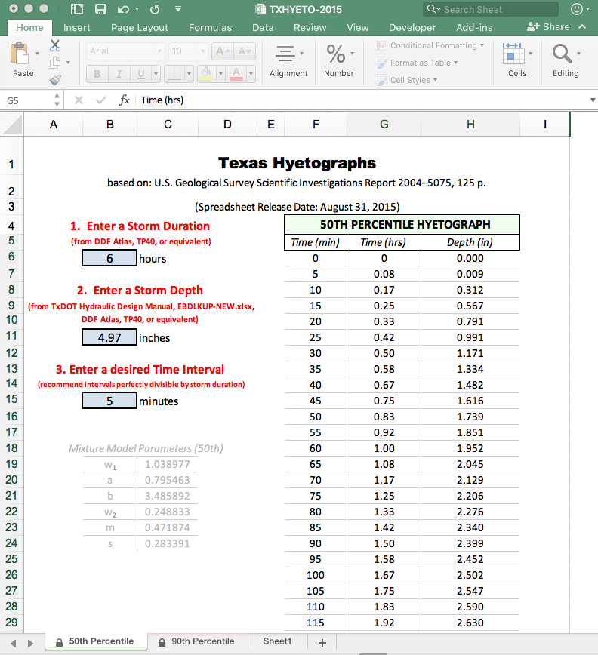
Application of design storm for tanglewilde
Using the Tanglewilde problem as an example
Does not specify storm type, so for completeness we will build using
SCS 6-hour
TXHYETO 6-hour
NOAA Atlas 14, Vol 11. 6-hour, 5-year depth is 4.97 inches
Use interpolation to get onto uniform time intervals

Slide 32
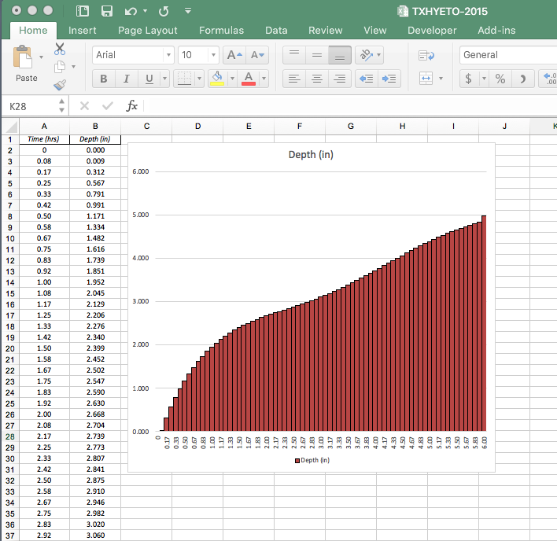
Application of design storm for tanglewilde
Using the Tanglewilde problem as an example
Does not specify storm type, so for completeness we will build using
SCS 6-hour
TXHYETO 6-hour
NOAA Atlas 14, Vol 11. 6-hour, 5-year depth is 4.97 inches
Using TXHYETO-2015, no interpolation needed

